Slide 1


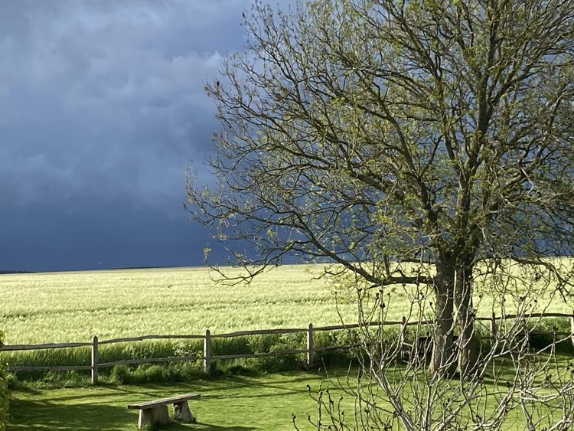



Believe in Talking
Counselling Services
Welcome to Believe in Talking
My name is Anna and I’m a Psychodynamically trained counsellor offering in-person and online counselling sessions to adults.
I believe that talking to a trained, professional counsellor in a safe, confidential place can help people to understand why they are struggling to cope with modern life challenges.
You (client)
The problems
Counselling room
Me (Counsellor)
Practicalities
Contact

Slide 2
Believe in Talking
Counselling Services
Photo: poppies
You as a prospective client considering counselling
You are reading this page probably because you are seeking counselling for a well-defined diagnosis or because an unclear problem within you impacts your life.
You might have had past experience with counselling already, or this might be the first time you’ve considered it. You are also trying to understand all the confusing counselling options available in terms of modality, timing and lengths. Finding a counsellor is often difficult also because the easiest fit might not be the right one.
I would be happy to have an initial, free of charge online consultation where I would be interested to know the main reason why you are seeking counselling, and some basic information about you such as age, occupation, support network. We can explore if psychodynamic counselling is a suitable fit for you. We will see if we can find a mutually convenient time/place for our sessions.
If we decide to progress, our 2nd step is an online or in person assessment session. This could take around 1.5 hour and will be a strictly confidential discussion. This is the first opportunity we can talk more in depth which would allow us to see if our counselling relationship could work. There might be specific situations whereby I could not take you as a client, in which case I will explain the reason.
After the assessment session, you have the choice to decide to go further or not. The fee for the assessment will be waved if you started counselling with me.
If we both agree to start counselling, we will set a specific time and place (in person or online) where we would meet every week.
Before the first counselling session I will send you a few documents you will be asked to fill in and return. Information about logistics of the sessions will be provided in advance.

Slide 3
Believe in Talking
Counselling Services
The broad type of problems I help my clients with:
Photos : complicated tree
Abuse
Anxiety
Bereavement
Burn out at work
Cultural and integration issues
Depression
Health related issues
Loss
Low self-esteem
Personal development
Redundancy
Relationship issues
Shyness
Suffering from/ addiction to social media
Stress
Trauma
Weight gain/overeating (as addiction)
Work related issues

Slide 4
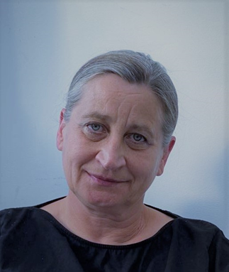
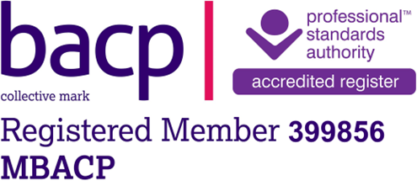
Photo: faded tulips
Believe in Talking
Counselling Services
Introducing myself as counsellor
Normally, in a counselling relationship, clients don’t need to know much about their counsellor. It is because that is the only way how a counsellor could remain neutral and unbiased. However, I understand that in order to enter into a so-called therapeutic relationship where trust is key, the client would need to know some basics about their counsellor.
I’m primarily a Psychodynamic counsellor meaning that I use the principles of psychotherapy. I was trained in a BACP accredited training course.
I’m also a Doctor of Pharmacy and before becoming a counsellor, I worked in the pharmaceutical research industry for many years. Understanding how drugs generally work, helped me to find the balance between modern scientific advances (such as medication) and deeper emotional wellbeing provided by counselling. I believe medication and counselling would best work together.
When working with clients, I respect the client’s diagnosis made by themselves or by health care professionals. However instead of keeping my clients in that defined “box of diagnosis” and “deal with” it, I tend to try to discover the invisible links between the different parts (past and present) of the client’s life.
For me the meaning of successful counselling is not measured by a specific achievement. It is a slow, constantly changing progress of how my clients think and feel about themselves and others.
I am a Registered Member of the BACP (British Association for Counselling and Psychotherapy) and work within the BACP Ethical Framework for the Counselling Professions. This includes the requirement that I attend regular supervision to discuss my client work with an experienced colleague, and that I undertake ongoing professional development.

Slide 5
Photo: view from my garden
Believe in Talking
Counselling Services
What happens in our counselling room (in person or virtual)?
Counselling always takes place in a strictly confidential environmental for both you (client) and me (counsellor).
I will be available for our discussion precisely at the start of the agreed hour and will finish 50 minutes later.
Primarily, the counselling space is yours; I’m there to listen but it does not mean that I’m passive. I’m interested in you, your struggles, emotions and everything that is an important part of you.
I’m there as an unbiased “other” person who could help to process what you cannot do yourself.
Every counselling session is unique and there is no homework or pre-planning involved. You just have to turn up and be truly yourself in that moment and space.

Slide 6
Believe in Talking
Counselling Services
Important Practicalities
Photo: multiple flowers
I offer both long term (open ended) and short term (~16 weeks) counselling. At present, I’m only accepting individual adult (18+) clients.
Counselling sessions can be
In person in my home practice near Chichester, West Sussex, UK. (the exact address will be provided during the Introductory or Assessment session)
Online for clients within and outside of UK using either Teams or Zoom.
My availability for sessions often changes but it is broad, and it can include weekday evenings (5PM and 6PM) and Saturday morning (9, 10 and 11AM) UK time.
My usual fee is £50 per session however
I offer discounted rate (£25) to students and people who live on benefits.
The fee for clients outside of UK to be confirmed
I ask clients to accept/sign a counselling contract with me (BelieveinTalking Ltd) before counselling starts. The terms and conditions are clearly defined including cancellation of individual sessions (at least 24hrs before) and 3 weeks’ notice period to end counselling.
My preferred client communication outside of the counselling sessions is via email: believeintalking@hotmail.com
Language of counselling is English

